Slide 1


Adversary Emulation Framework
Mentors: Dr. Alcides Alvear Suarez & Robel Campbell
Integrants: Kiara Rivera Domenech, Genesis Resto, Carlos Roque
Date: September 19th, 2023

Slide 2
Table of Contents
Command and Control Framework (C2) and Structure Diagram context
Project Improvements: Implant, Server and Interface
Diagrams: Implant and Listeners tab
References
Q&A
G. Resto, K. Domenech, C. Roque Adversary Emulation Framework
2

Slide 3

Project Context
G. Resto, K. Domenech, C. Roque Adversary Emulation Framework
3

Slide 4

Command and Control Framework
Dynamic Evasion – Variable Syscalls, ETW/AMSI Patching
In-memory Execution – Download Cradles, Microcontroller
Encrypted Payloads – AES-256, XOR
G. Resto, K. Domenech, C. Roque Adversary Emulation Framework
4

Slide 5
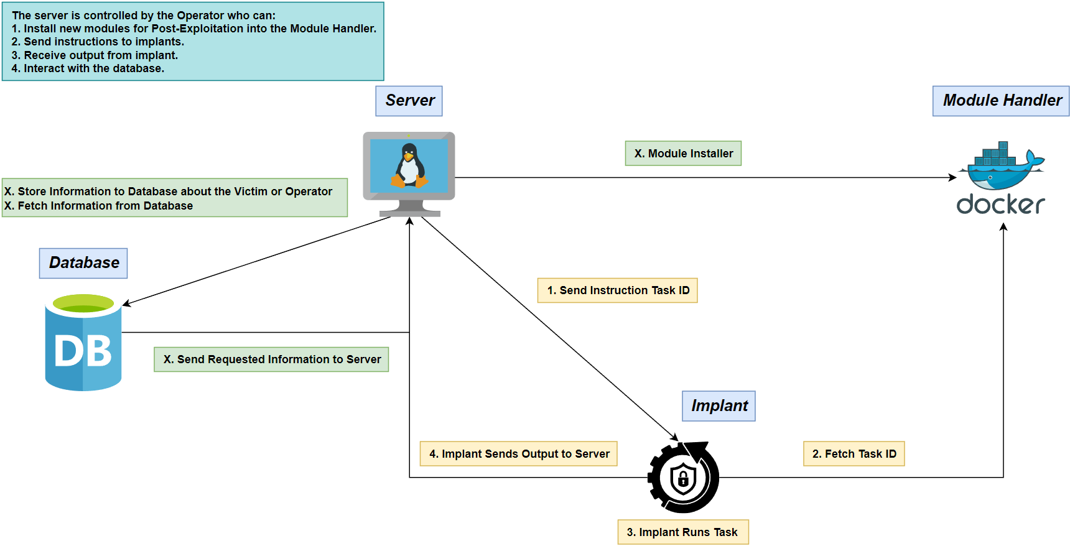
Structure Diagram
G. Resto, K. Domenech, C. Roque Adversary Emulation Framework

Slide 6
Project Improvements
G. Resto, K. Domenech, C. Roque Adversary Emulation Framework

Slide 7
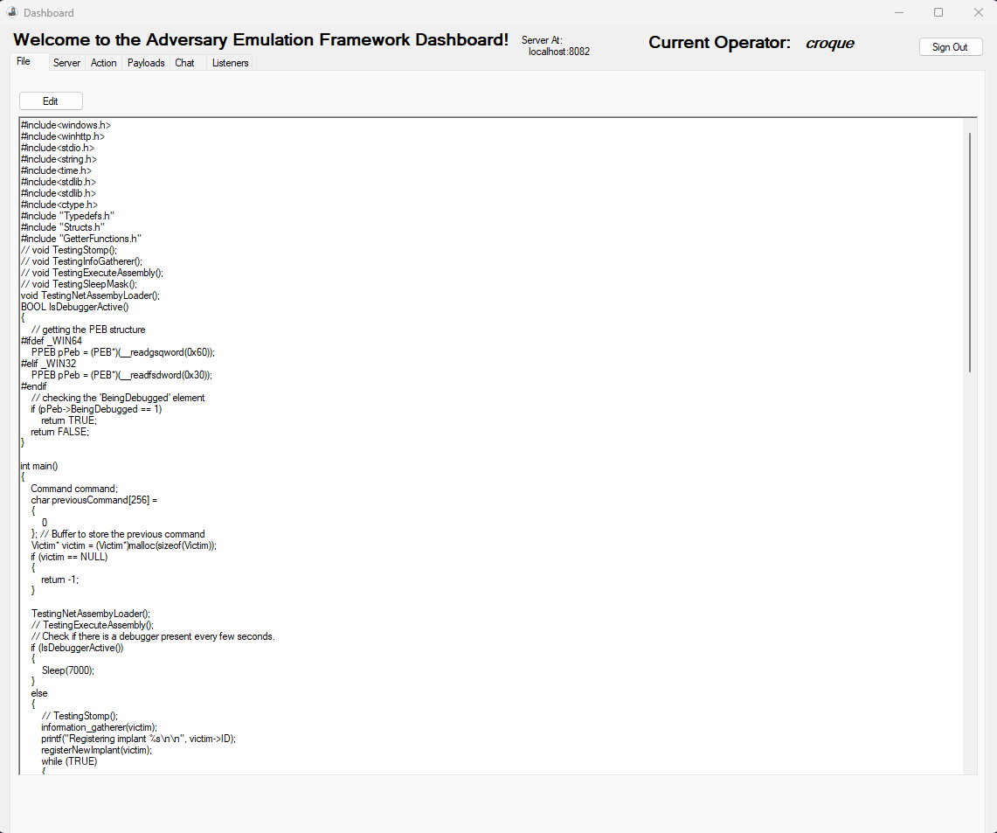
File tab

Slide 8
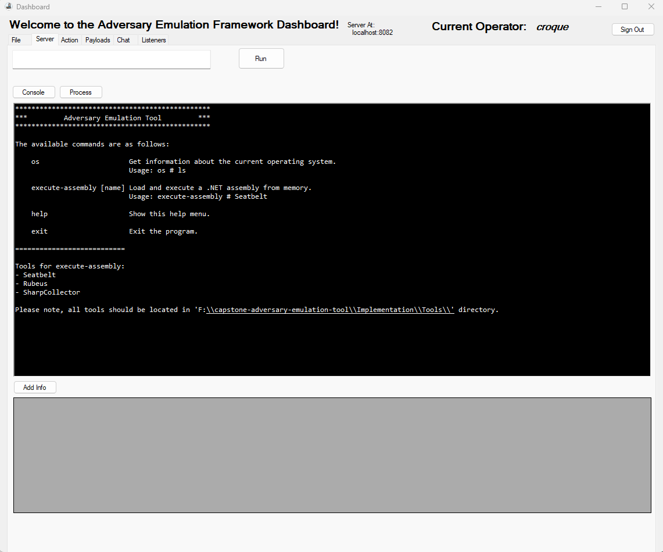
Server tab

Slide 9
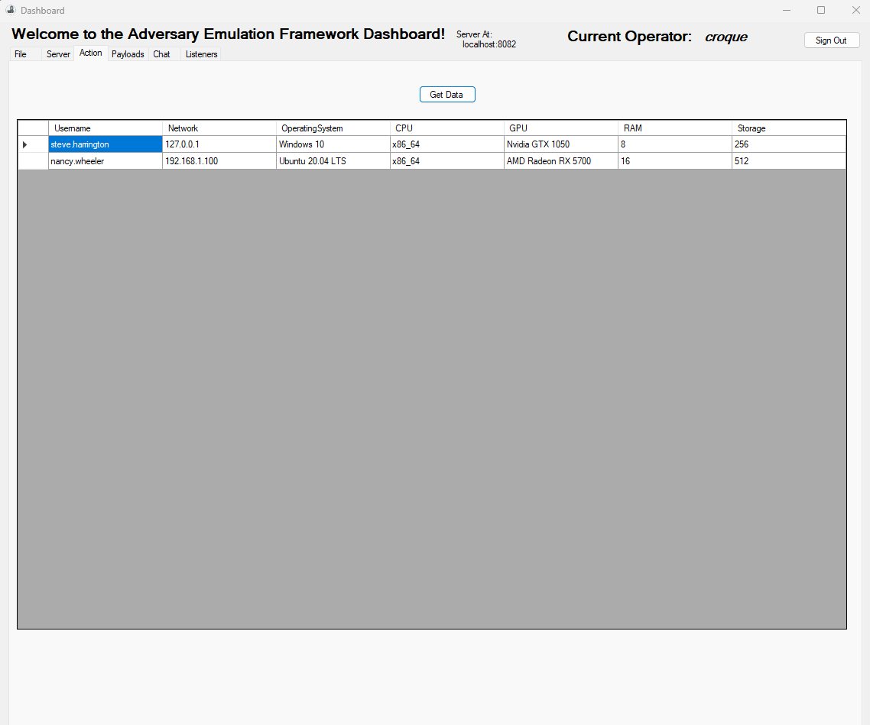
Action tab

Slide 10
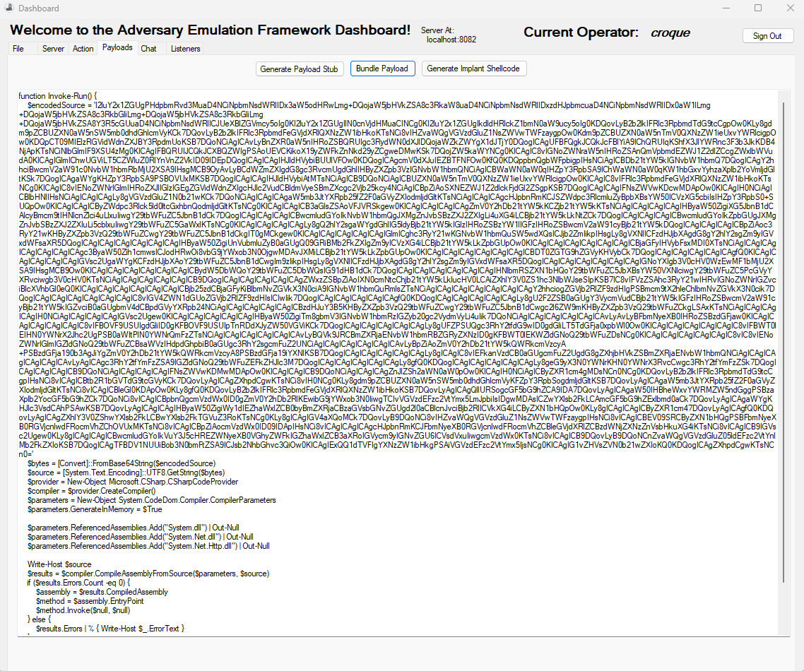
Payloads tab

Slide 11
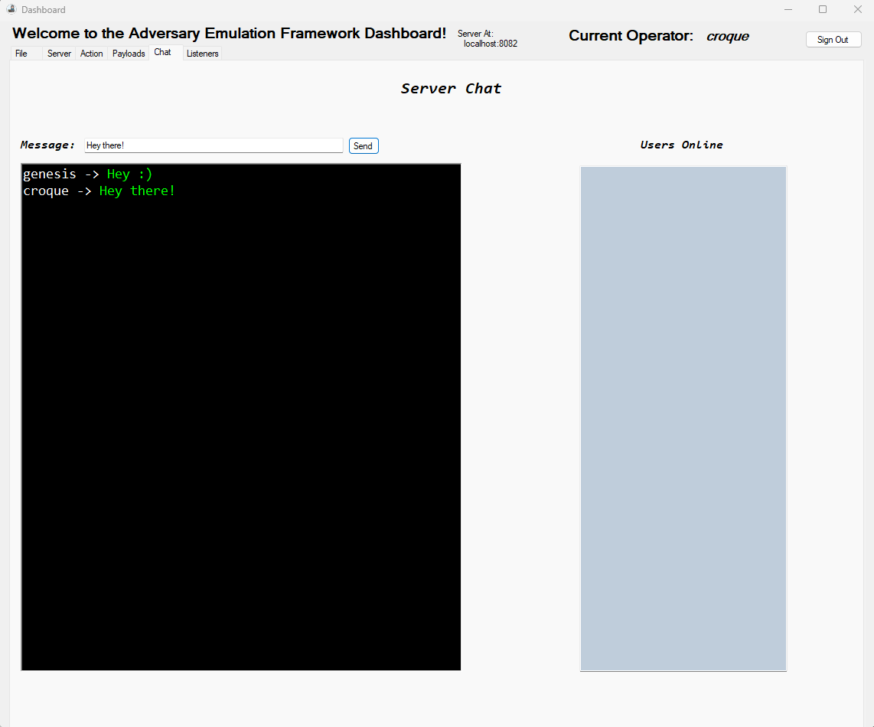
Chat tab

Slide 12
Initial Backlog Methodology: Scrum
G. Resto, K. Domenech, C. Roque Adversary Emulation Framework

Slide 13
Implant
Basic Post-Exploitation:
System Enumeration
Evasion Techniques:
Module Stomping
Heap Encryption
Thread Call Stack Spoofing
Persistence
Data Exfiltration
Anti-Debugging/Virtual Machine
Encryption
G. Resto, K. Domenech, C. Roque Adversary Emulation Framework

Slide 14

Server
Multiple Listener Creation
Authorization
GeoIP-Based Identification
Scriptable Modules
G. Resto, K. Domenech, C. Roque Adversary Emulation Framework

Slide 15

Interface
Real-time Monitoring for Implant
New tab:
Listener Creation
G. Resto, K. Domenech, C. Roque Adversary Emulation Framework
9

Slide 16
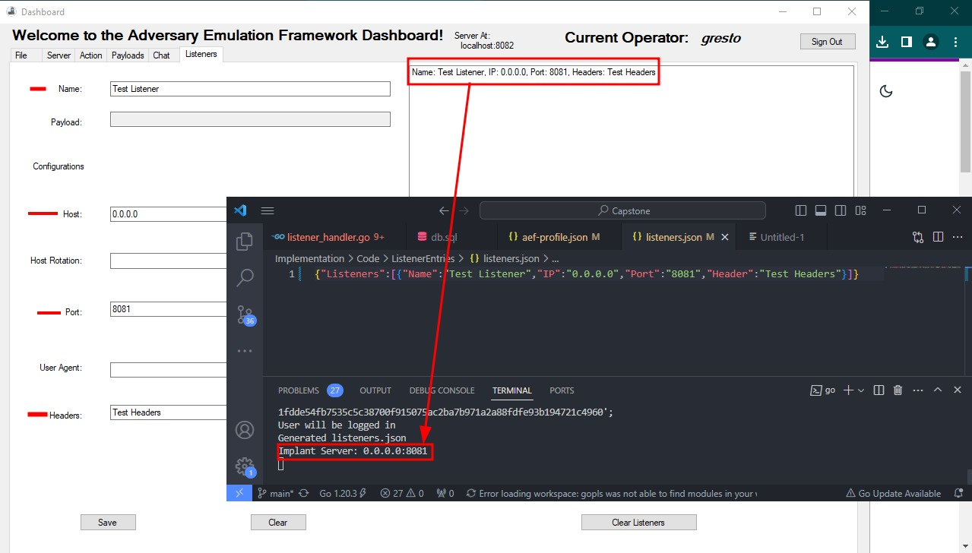
Listeners tab

Slide 17

Module Handler
Upload sharp collection
Python script for downloading modules
Custom DLL code
G. Resto, K. Domenech, C. Roque Adversary Emulation Framework

Slide 18
Diagrams

Slide 19
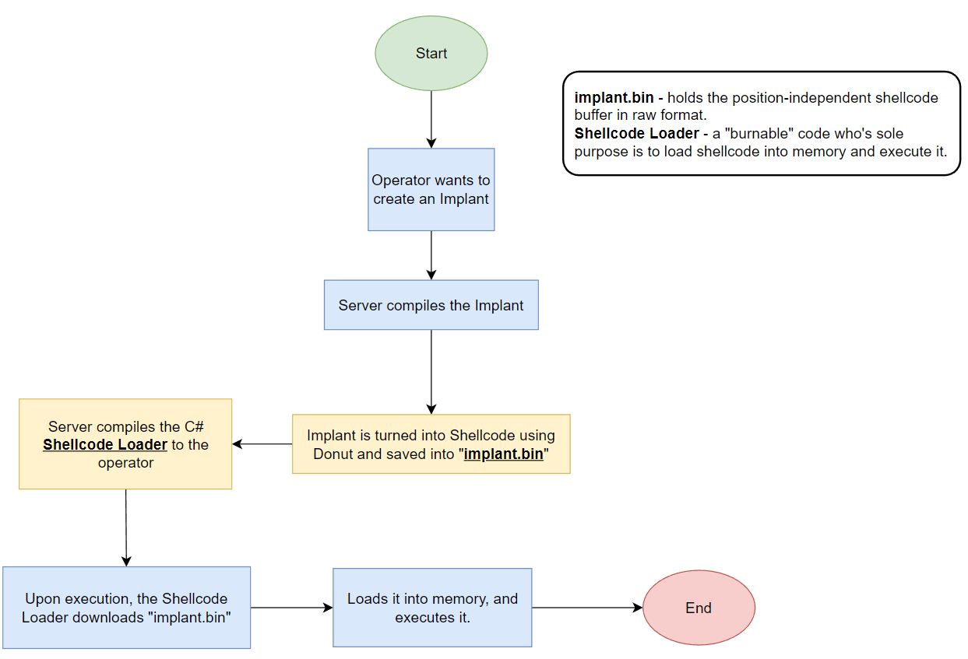
Implant Loading
G. Resto, K. Domenech, C. Roque Adversary Emulation Framework

Slide 20
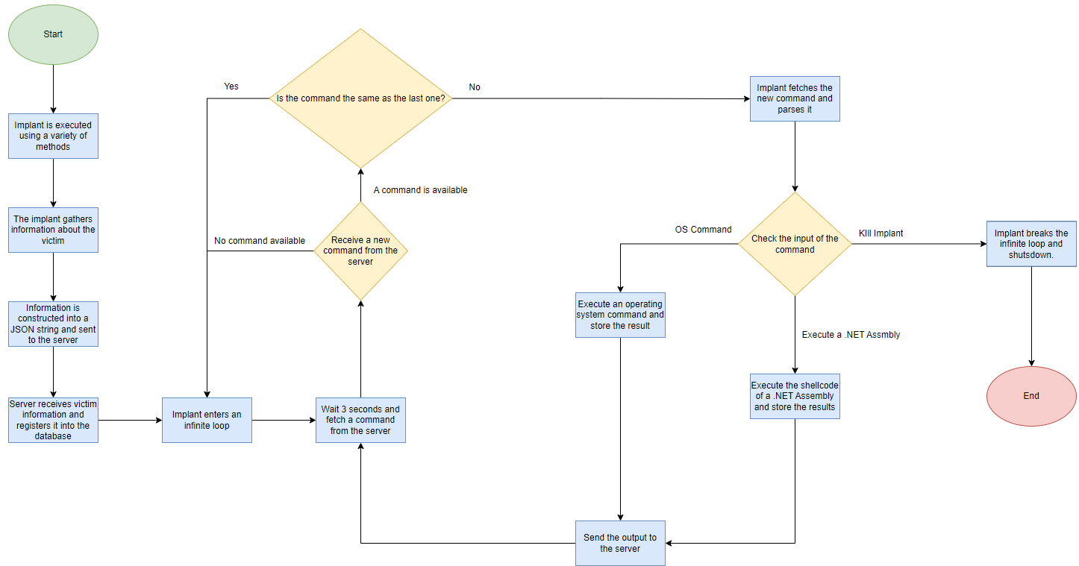
Implant Execution
G. Resto, K. Domenech, C. Roque Adversary Emulation Framework

Slide 21
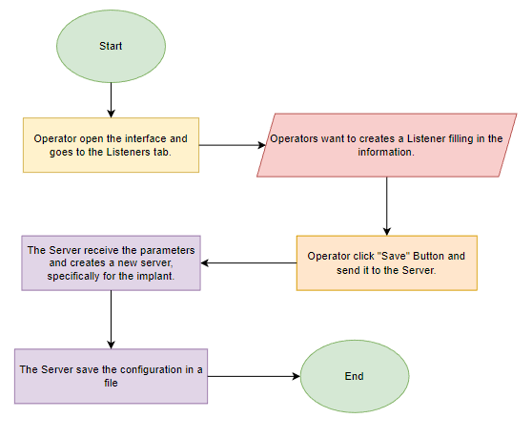
Listeners Creation

Slide 22
References
Microsoft (2023, February). Dynamic Language Runtime Overview - .NET Framework. Microsoft Learn. https://learn.microsoft.com/en-us/dotnet/framework/reflection-and-codedom/dynamic-language-runtime-overview
The Wover (2019, May). Donut – Injecting .NET Assemblies as Shellcode. TheWover. https://thewover.github.io/Introducing-Donut/
Daniel Feichter (2023). Direct Syscalls – A Journey from High to Low. Daniel Feichter. https://redops.at/en/blog/direct-syscalls-a-journey-from-high-to-low
Ali Awan, A. (2022, July). A Comprehensive Introduction to Graph Neural Networks (GNNs). https://www.datacamp.com/tutorial/comprehensive-introduction-graph-neural-networks-gnns-tutorial
G. Resto, K. Domenech, C. Roque Adversary Emulation Framework
22

Slide 23

Thank you

